Slide 1
SYSTEM MONITORING AND INSTRUMENTATION IN VIRTUAL Final year project date : 25-03-2024
TEAM MEMBERS: GUIDED BY:
SRIVARSHINI T(2020PECCS186) DR.A.HEMLATHADHEVI
RITIKAA R (2020PECCS170)

Slide 2
BASE PAPER
THE VIEW ON SYSTEMS MONITORING AND ITS REQUIREMENTS FROM FUTURE CLOUD-TO-THING APPLICATIONS AND INFRASTRUCTURES - 2023 PAPER

Slide 3
ABSTRACT
Monitoring provides real-time insights into the system's behavior, allowing stakeholders to track performance metrics and identify potential issues promptly.
Instrumentation enables the detection of anomalies or deviations from normal behavior, allowing for proactive problem resolution before they escalate.
Instrumentation helps in tracking resource utilization, such as CPU, memory, and network usage, allowing for efficient allocation and utilization of resources.

Slide 4
In the context of instrumentation and monitoring logs, traces, and metrics are essential components that provide insights into the behavior and performance of a system.
logs can provide details about specific errors, traces can show how those errors propagate through the system, and metrics can give an overall performance context.
These Tools play crucial roles in instrumenting systems, providing developers, system administrators, and DevOps teams with the necessary visibility and insights to ensure the reliability, performance, and security of applications and infrastructure. The choice of tool depends on specific requirements, the nature of the system, and the types of data that need to be monitored.

Slide 5
EXISTING SYSTEM
Monitoring in an IoT (Internet of Things) system involves the continuous observation and collection of data from connected devices, sensors, and systems. The primary goal is to ensure the reliability, performance, security, and efficiency of the IoT ecosystem.
Monitoring systems often support remote management capabilities, allowing users to configure devices, update firmware, and troubleshoot issues without physical access.

Slide 6
DISADVANTAGES
The sheer volume of data generated by numerous IoT devices can overwhelm monitoring systems, making it challenging to analyze and extract meaningful insights.
Scaling IoT monitoring systems to accommodate a growing number of devices can be challenging. Ensuring performance and responsiveness as the IoT ecosystem expands requires careful planning.
Regular updates and adaptability to evolving technologies are essential to overcoming disadvantages and optimizing IoT monitoring effectiveness.

Slide 7
PROPOSED SYSTEM
Monitoring systems set predefined thresholds and rules to trigger alerts when certain conditions or anomalies are detected. the cloud-to-thing concept enables a powerful and flexible infrastructure for IoT deployments.
Visualization tools create dashboards that display real-time and historical data trends. This allows users to monitor the performance and status of devices and systems.
Advanced analytics, machine learning algorithms, and other processing mechanisms are applied to the data to derive meaningful insights, detect patterns, and identify anomalies.

Slide 8
ADVANTAGES
The use of these tools enhances the efficiency, reliability, and management of the instrumentation system. They contribute to proactive monitoring, quick decision-making, and the overall optimization of the system's performance.
By sending data to the cloud, devices can offload heavy computational tasks, allowing centralized and powerful cloud servers to process and analyze data efficiently.
Instrumentation allows for remote monitoring and management of devices and processes, reducing the need for physical presence and on-site interventions.

Slide 9
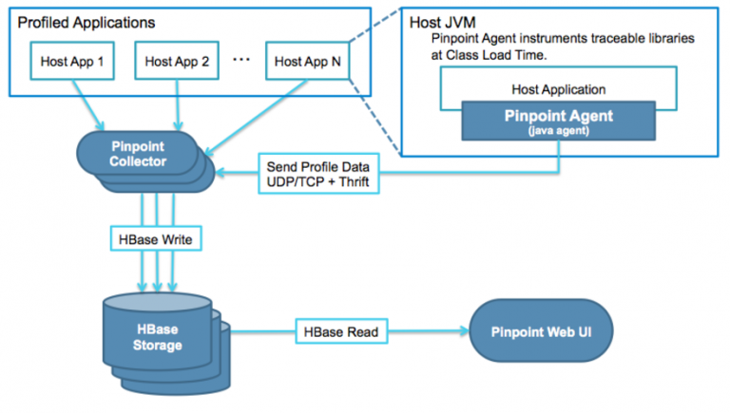
ARCHITECTURE DIAGRAM

Slide 10
ENVIRONMENT REQURIMENTS
SOFTWARE REQUIREMENTS:
Ubuntu LS-20.0.7
Java Development Kit - JAVA 8, JAVA 17, JAVA 21
Spring Boot initializer
Idea Community IDE
HBase Hadoop 0.98.2
Pinpoint Web viewer
HARDWARE REQUIREMENTS:
Processor: Intel i5 or above
Memory (RAM): 16 GB
Hard Drive: 32 GB
Internet Connection

Slide 11
MODULES
Hbase (for storage)
Building Pinpoint
Pinpoint Collector (deployed on a web container)
Pinpoint Web (deployed on a web container)
Pinpoint Agent (attached to a java application for profiling)

Slide 12
1.HBASE
Pinpoint uses HBase as its storage backend for the Collector and the Web.
Tables in HBase are automatically shared into regions, and each region is assigned to a region server. This sharing mechanism allows HBase to efficiently distribute data across the cluster and balance the load among region servers.
To set up your own cluster, take a look at the HBase website for instructions. Once you have HBase up and running, make sure the Collector and the Web are configured properly and are able to connect to HBase.

Slide 13
Start Loop: Begin an infinite loop to continuously monitor the HBase cluster.
Get Region Servers: Obtain a list of all region servers in the HBase cluster using the getHBaseRegionServers() function.
Iterate Through Region Servers: For each region server in the list obtained:
a. Check Status: Use the check HBaseRegionServerStatus(regionserver) function to determine the status of the region server.
b. Evaluate Status: If the status is "healthy": Log a message indicating that the region server is healthy.
If the status is "unhealthy": Log a message indicating that the region server is unhealthy and attempt to restart it using the restart HBaseRegionServer (regionserver) function.
Log a message confirming that the region server has been restarted.
If the status is neither "healthy" nor "unhealthy": Log a message indicating an unknown status for the region server.
Sleep: Pause the execution for 5 minutes (300 seconds) using the sleep(300) function before checking the cluster again.
End Loop: Repeat the process indefinitely.

Slide 14
2.BUILDING PINPOINT
Download the build results from our latest release and skip building process.
Ensure that your infrastructure meets the system requirements for running Pinpoint. This may include having a suitable Java runtime environment, a compatible web server, and other dependencies.
Obtain the Pinpoint binaries or source code, and follow the installation instructions provided by Pinpoint. This might involve configuring the Pinpoint Collector, Web UI, and Agents.

Slide 15
3.PINPOINT COLLECTOR
Set up the Pinpoint Collector, which aggregates performance data from application agents.
Pinpoint Collector is a crucial component in the Pinpoint application performance monitoring (APM) system. It serves as the central point for aggregating, storing, and managing performance data collected from various application instances by Pinpoint agents. The collector plays a key role in providing a centralized repository for performance metrics, allowing users to analyze and visualize the data through the Pinpoint Web UI.

Slide 16
4. PINPOINT WEB
Pinpoint Web is the web-based user interface component of the Pinpoint application performance monitoring (APM) system. It provides a graphical interface for users to monitor, analyze, and visualize performance data collected from Java applications. Pinpoint Web allows users to gain insights into the behavior of their applications, identify performance bottlenecks, and troubleshoot issues.
It provides an intuitive and interactive interface for monitoring and managing the performance of Java applications in real-time and over historical periods.

Slide 17
5.PINPOINT AGENT
The Pinpoint agent is a crucial component of the Pinpoint application performance monitoring (APM) system. It is responsible for instrumenting Java applications to collect performance data, including traces, transactions, and other key metrics. The collected data is then sent to the Pinpoint Collector for aggregation and analysis.
The Pinpoint agent is a critical component for users looking to monitor and optimize the performance of Java applications. Its ability to instrument code, collect granular performance data, and communicate with the Pinpoint Collector facilitates application performance monitoring.

Slide 18
Set Agent ID: Define the agent ID as "agent-1".
Set Collector Address and Port: Assign the collector address as "collector.example.com".
Set the collector port as 9090.
Set Application Name: Define the application name as "MyApplication".
Configure Agent ID: Call the function "configureAgentID()" with the agent ID as an argument to set the ID for the Pinpoint agent.
Configure Collector Address and Port: Call the function "configureCollectorAddress()" with the collector address and port as arguments to configure the Pinpoint agent with the provided address and port.
Configure Application Name: Call the function "configureApplicationName()" with the application name as an argument to set the name for the Pinpoint agent's application.
Start Agent: Invoke the function "startAgent()" to initiate the Pinpoint agent.
Log Agent Start: Generate a log message indicating that the Pinpoint agent has started with the specified ID and application name.

Slide 19
COMPARISON TABLE
EXISTING SYSTEM
PROPOSED SYSTEM
Monitoring in an IoT (Internet of Things) system involves the continuous observation and collection of data from connected devices, sensors, and systems.
Monitoring systems set predefined thresholds and rules to trigger alerts when certain conditions or anomalies are detected. The cloud-to-thing concept enables a powerful and flexible infrastructure for IoTdeployments and visualization tools.

Slide 20
LITERATURE SURVEY
S.NO | YEAR | AUTHOR | PAPER TITLE | METHOLOGY | LIMITATION
1. | 2018 | Vlado Stankovski, Andrew C. Jones | Monitoring self-adaptive applications within edge computing frameworks: A state-of-the-art review | The edge computing paradigm has introduced new functionalities of service migration such as movement of running services between the centralized cloud computing layer and the edge computing layer to support load-balancing on-demand | They have no known competing financial interests or personal relationships that could have appeared to influence the work reported in this paper

Slide 21
S.NO | YEAR | AUTHOR | PAPER TITLE | METHOLOGY | LIMITATION
2. | 2021 | Moya , N. ., Biswas, G. ., J. Alonso-Gonzalez , C. ., & Koutsoukos | Structural observability. Application to decompose a system with possible conflicts | Model based diagnosis of large continuous Distribution can be obtained partitioning the original diagnosis problem into the analysis of simpler subproblems. In this work, Possible Conflicts are used to partition a system because they provide a systematic way to decompose a system | Costly subscription to use and difficulty in constructing at traffic rate (remote based application)

Slide 22
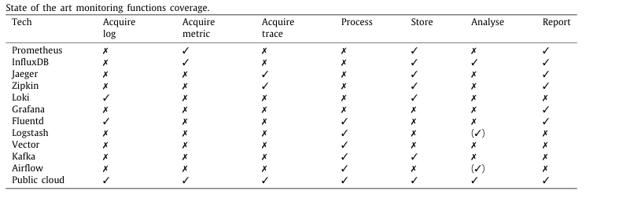
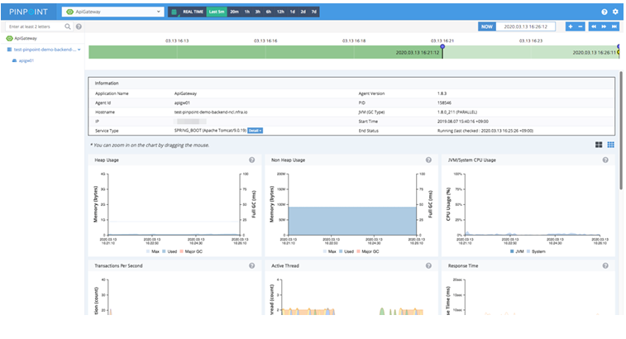
MONITORING FUNCTION COVERAGE

Slide 23
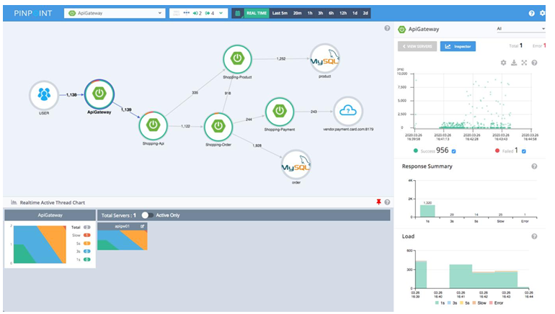
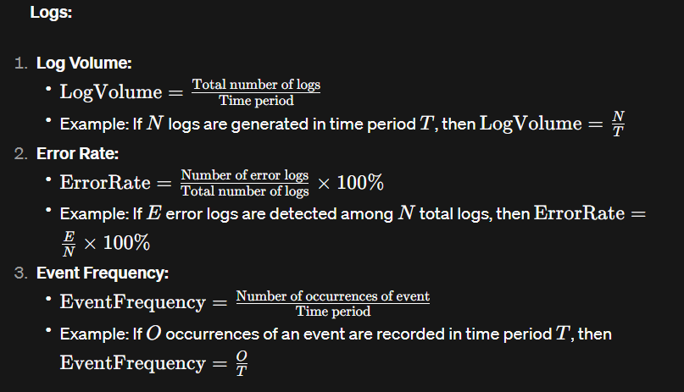

Slide 24
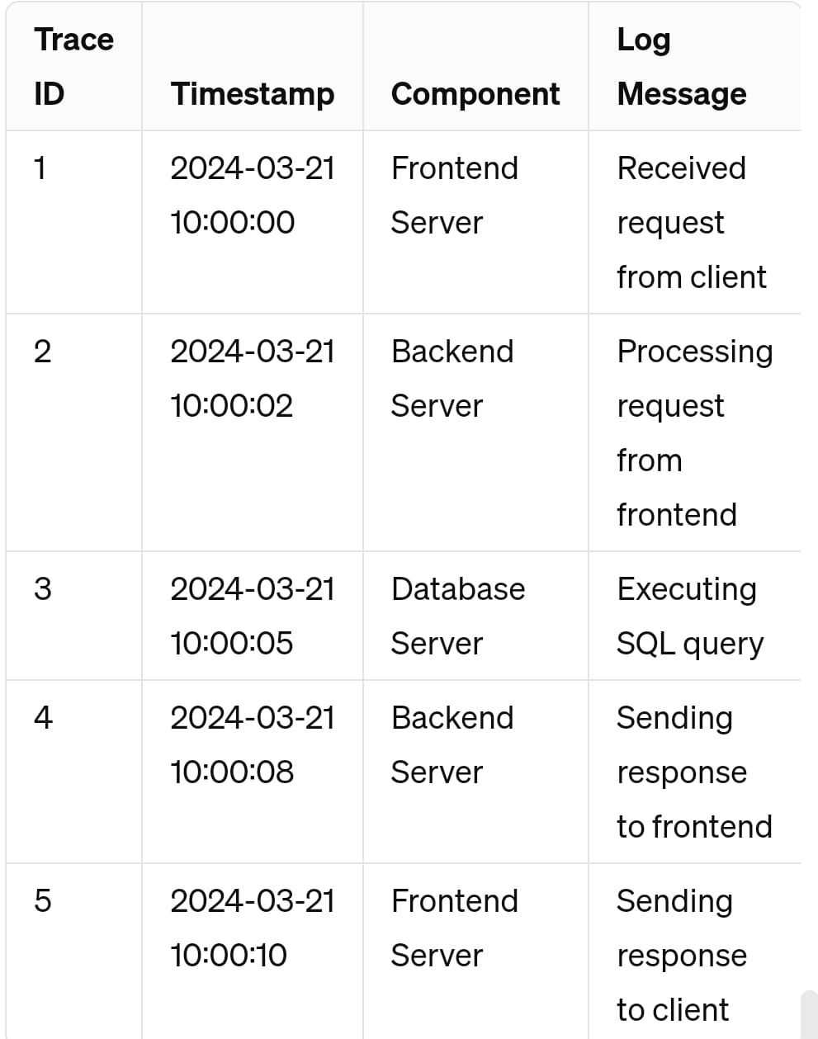
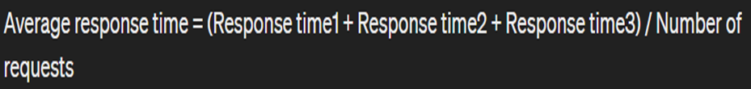

Slide 25
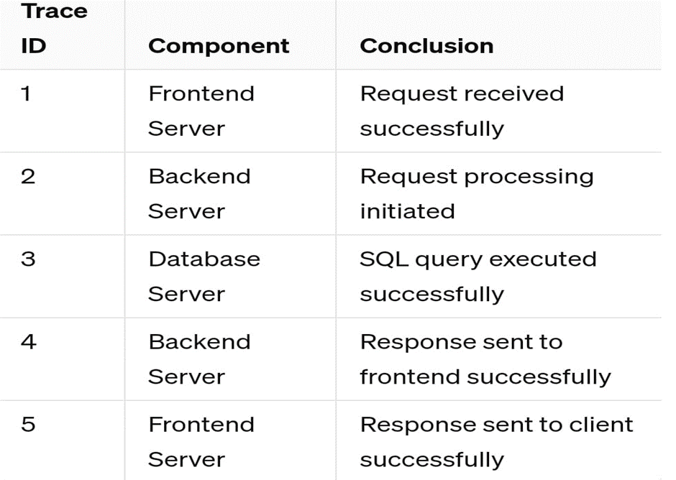

Slide 26
CALCULATIONS:
LOGS
log volume:
Given: 1000 log entries in a 1-hour period.
Calculate: Log volume per hour.
Solution:
Log volume per hour = Total number of logs / Time period
Log volume per hour = 1000 logs / 1 hour = 1000 logs/hour
Error Rate:
Given: 50 error logs out of 1000 total logs.
Calculate: Error rate as a percentage.
Solution:
Error rate = (Number of error logs / Total number of logs) * 100%
Error rate = (50 / 1000) * 100% = 5%
Event Frequency:
Given: Log data containing API endpoint accesses.
Calculate: Frequency of a specific API endpoint accessed within a given period.
Solution: Count the occurrences of the specific API endpoint accessed within the given period.

Slide 27
METRICS:
Average Response Time:
Given: Response times of 100 ms, 200 ms, and 300 ms for three requests.
Calculate: Average response time.
Solution:
Average response time = (Response time1 + Response time2 + Response time3) / Number of requests
Average response time = (100 ms + 200 ms + 300 ms) / 3 = 600 ms / 3 = 200 ms
90th Percentile Response Time:
Given: Response times sorted in ascending order, with the 90th percentile at 250 ms.
Determine: Response time below which 90% of requests fall.
Solution: The 90th percentile response time is directly given as 250 ms.
Throughput:
Given: 1000 requests served in 1 minute.
Calculate: Throughput in requests per minute.
Solution:
Throughput = Number of requests / Time period
Throughput = 1000 requests / 1 minute = 1000 requests/minute

Slide 28
REFERENCES
[1] M.F. Lie, M. Sánchez-Gordón, R. Colomo-Palacios, DevOps in an ISO 13485 regulated environment, in: Proceedings of the 14th ACM / IEEE Interna tional Symposium on Empirical Software Engineering and Measurement (ESEM), ACM, 2020, http://dx.doi.org/10.1145/3382494.3410679
[2] M. Rajkumar, A.K. Pole, V.S. Adige, P. Mahanta, DevOps culture and its impact on cloud delivery and software development, in: 2016 Interna tional Conference on Advances in Computing, Communication, Automation (ICACCA) (Spring), 2016, pp. 1–6, http://dx.doi.org/10.1109/ICACCA.2016. 7578902.
[3] M. Abderrahim, M. Ouzzif, K. Guillouard, J. Francois, A. Lebre, A holistic monitoring service for fog/edge infrastructures: A foresight study, in: 2017 IEEE 5th International Conference on Future Internet of Things and Cloud (FiCloud), 2017, pp. 337–344, http://dx.doi.org/10.1109/FiCloud.2017.30.

Slide 29
[4] C. Tsigkanos, S. Nastic, S. Dustdar, Towards resilient internet of things: Vision, challenges, and research roadmap, in: 2019 IEEE 39th Interna tional Conference on Distributed Computing Systems, ICDCS, 2019, pp. 1754–1764, http://dx.doi.org/10.1109/ICDCS.2019.00174.
[5] IEEE Standard Glossary of Software Engineering Terminology, IEEE Std 610.12-1990 (1990) 1–84, http://dx.doi.org/10.1109/IEEESTD.1990.101064.
[6] C. Berger, P. Eichhammer, H.P. Reiser, J. Domaschka, F.J. Hauck, G. Habiger, A survey on resilience in the IoT: Taxonomy, classification and discus sion of resilience mechanism, ACM Comput. Surv. (2021) accepted for publication. [7] G. Lee, B.-G. Chun, R.H. Katz, Heterogeneity-Aware Resource Allocation and Scheduling in the Cloud 5.
[8] M. Iorga, L. Feldman, R. Barton, M. Martin, N. Goren, C. Mahmoudi, The nist definition of fog computing, Tech. rep., National Institute of Standards and Technology, 2017.
[9] V. Karagiannis, S. Schulte, Comparison of alternative architectures in fog computing, in: 2020 IEEE 4th International Conference on Fog and Edge Computing, ICFEC, IEEE, 2020, pp. 19–28.

Slide 30
[10] S. Taheri Zadeh, A.C. Jones, I. Taylor, Z. Zhao, V. Stankovski, Monitoring self-adaptive applications within edge computing frameworks: A state-of the-art review, J. Syst. Softw. 136 (2018) 19–38, http://dx.doi.org/10.1016/ j.jss.2017.10.033.
[11] O. Bello, S. Zeadally, M. Badra, Network layer inter-operation of device to-device communication technologies in internet of things (IoT), Ad Hoc Netw. 57 (C) (2017) 52–62, http://dx.doi.org/10.1016/j.adhoc.2016.06.010.
[12] J.S. Ward, A. Barker, Observing the clouds: a survey and taxonomy of cloud monitoring, J. Cloud Comput. 3 (1) (2014) 1–30. [13] J. Joyce, G. Lomow, K. Slind, B. Unger, Monitoring distributed systems, ACM Trans. Comput. Syst. 5 (2) (1987) 121–150, http://dx.doi.org/10.1145/ 13677.22723.

Slide 31
THANK YOU

